Slide 1

DEPARTMENT OF ARTIFICIAL INTELLIGENCE AND DATA SCIENCE
Vision
To impart international quality education, promote collaborative research and graduate industry-ready engineers in the domain of Artificial Intelligence and Data Science to serve the society.

Slide 2
Mission
Excel in Teaching-Learning process and collaborative Research by the use of modern infrastructure and innovative components.
Establish an Artificial Intelligence and Data Science based centre of excellence to prepare professional technocrats for solving interdisciplinary industry problems in various applications
Motivate students to emerge as entrepreneurs with leadership qualities in a societal centric programme to fulfil Industry and community needs with ethical standards

Slide 3
Program Educational Objectives (PEOs)
After successful completion of the degree, the students will be able to
PEO 1. Apply Artificial Intelligence and Data Science techniques with industrial standards and pioneering research to solve social and environment-related problems for making a sustainable ecosystems.
PEO 2. Excel with professional skills, fundamental knowledge, and advanced futuristic technologies to become Data Scientists, Data Analyst Managers, Data Science leaders AI Research Scientists, or Entrepreneurs

Slide 4
Program Specific Outcomes (PSOs)
PSO 1: To apply analytic technologies to achieve at meaningful insight and observation from data to solve engineering problems
PSO 2: To create and apply Artificial Intelligence and Data Science techniques to forecast future trends in the domain of Healthcare, Education, Agriculture, Manufacturing, Automation, Robotics, and Transport, etc
PSO 3: To enrich the critical thinking skills in emerging technologies such as Hybrid Mobile application development, cloud technology stack, and cyber-physical systems with mathematical aid to foresee the research findings and provide the solutions

Slide 5
AD3251 DATA STRUCTURES DESIGN L T P C 3 0 0 3
UNIT I ABSTRACT DATA TYPES 9
Abstract Data Types (ADTs) – ADTs and classes – introduction to OOP – classes in Python – inheritance – namespaces – shallow and deep copying . Introduction to analysis of algorithms – asymptotic notations – recursion – analyzing recursive algorithms

Slide 6
UNIT II LINEAR STRUCTURES 9
List ADT – array-based implementations – linked list implementations – singly linked lists – circularly linked lists – doubly linked lists – applications of lists – Stack ADT – Queue ADT – double ended queues
UNIT III SORTING AND SEARCHING 9
Bubble sort – selection sort – insertion sort – merge sort – quick sort – linear search – binary search – hashing – hash functions – collision handling – load factors, rehashing, and efficiency

Slide 7
UNIT IV TREE STRUCTURES 9
Tree ADT – Binary Tree ADT – tree traversals – binary search trees – AVL trees – heaps – multi-way search trees
UNIT V GRAPH STRUCTURES 9
Graph ADT – representations of graph – graph traversals – DAG – topological ordering – shortest paths – minimum spanning trees

Slide 8
COURSE OUTCOMES
At the end of the course, the student should be able to:
CO1: explain abstract data types
CO2: design, implement, and analyse linear data structures, such as lists, queues, and stacks, according to the needs of different applications
CO3:Implement Sorting and Searching techniques for given problems
CO4:design, implement, and analyse efficient tree structures to meet requirements such as searching, indexing, and sorting
CO5: implement efficient graph algorithms to solve graph problems

Slide 9
Data structures
Data structures
Storage and organization of data is known as data structure which define the relationship between data and operations
Types
Contiguous
Non-contiguous
Linear data structure
Non-Linear data structure

Slide 10
Data structures
Contiguous
Contiguous data items are stored in Contiguous memory location(EX. RAM, or File)
Non-contiguous
Data items are scattered across different memory locations(Linked list, tree, graph)
Linear data structure
The elements are accessed in a sequential order irrespective of whether data items are contiguous or non-contiguous(array, linked list, stack, queue)
Non-Linear data structure
The elements are accessed in a non linear order (tree, graph)

Slide 11
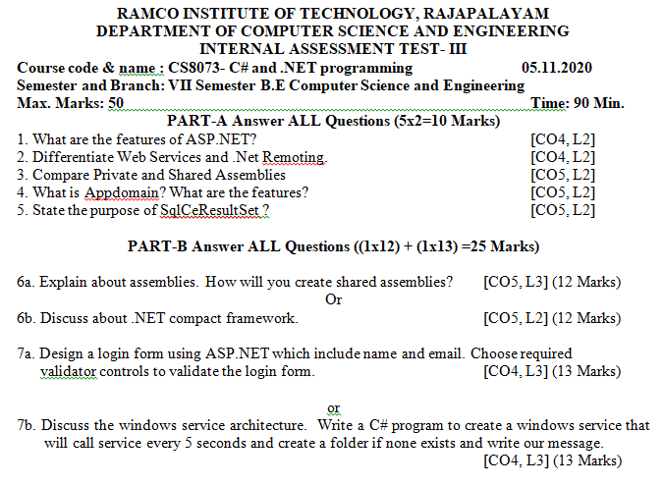
Data structures
Application of data structure
Array data structure
A question Paper is an array of numbered questions with each of them assigned to some marks

Slide 12

Data structures
Application of data structure
Linked list data structure
Images are linked with each other. So, an image viewer software uses a linked list to view the previous and the next images using the previous and next buttons
Image viewer

Slide 13
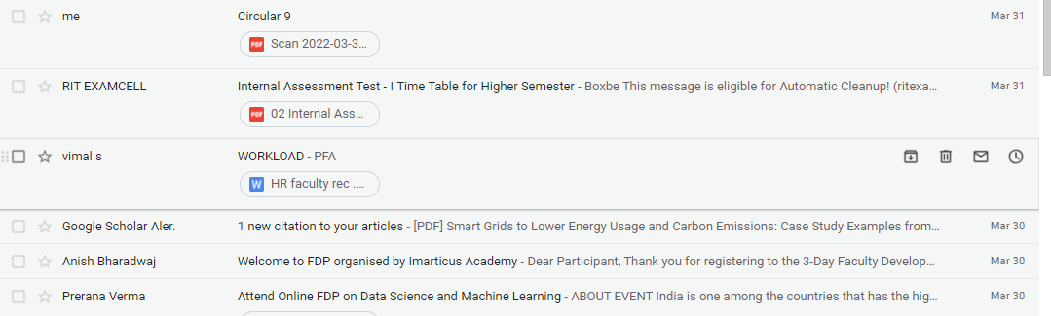
Data structures
Application of data structure
Stack data structure
E-mails, Google photos’ any gallery , YouTube downloads, Notifications ( latest appears first )

Slide 14

Data structures
Application of data structure
Graph data structure
GPS navigation system also uses shortest path APIs)

Slide 15
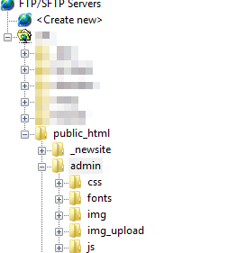
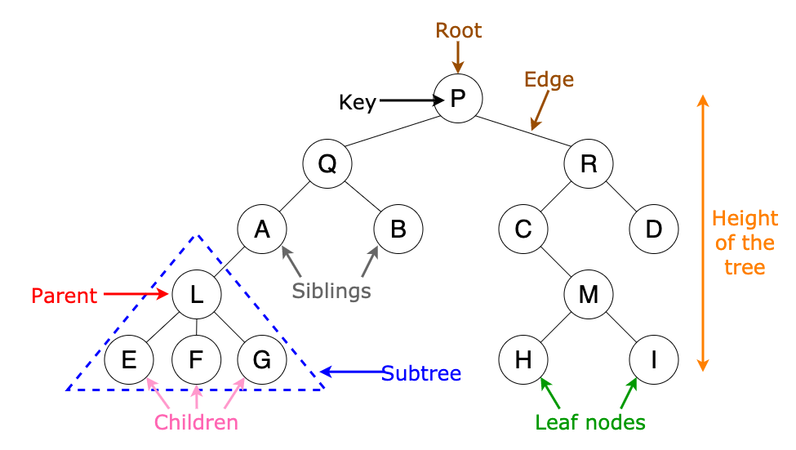
Data structures
Application of data structure
Tree data structure
File explorer/my computer of mobile/any computer
Algorithm of tree is used in machine learning for decision making

Slide 16
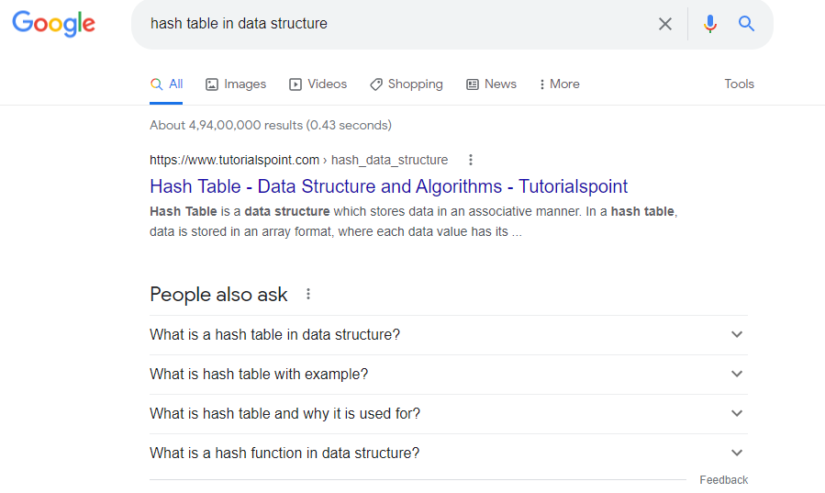
Data structures
Application of data structure
Hash table data structure
Every time we type something to be searched in internet browsers, it generates the desired output based on the principle of hashing

Slide 17
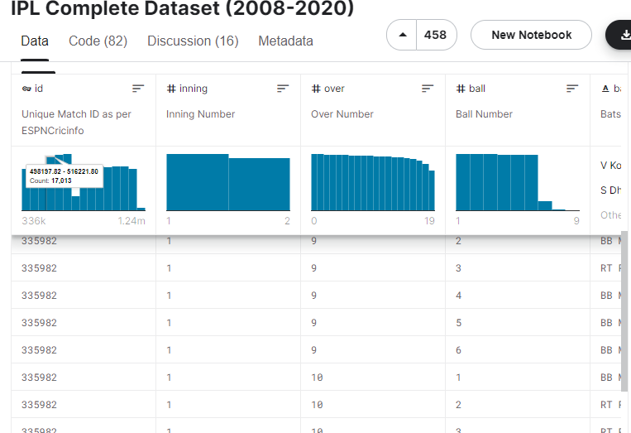
Data structures
Application of data structure
Matrix data structure
Used for plotting graphs, statistics to do scientific studies and research in different fields

